Slide 1

IoT Army of 300
Resource Development to enable Our Brightest Minds in Technology
Abdur Rahman
Lecture 6
ADC
Dec 10, 2017

Slide 2
ADC
ADC Tutorial:
http://maxembedded.com/2011/06/the-adc-of-the-avr/
http://extremeelectronics.co.in/avr-tutorials/using-adc-of-avr-microcontroller/

Slide 3
ADC
What is a Signal?
A signal is a pattern of variation of some form
Signals are variables that carry information
Examples of signal include:
Electrical signals
Voltages and currents in a circuit
Acoustic signals
Acoustic pressure (sound) over time
Mechanical signals
Velocity of a car over time
Video signals
Intensity level of a pixel (camera, video) over time

Slide 4
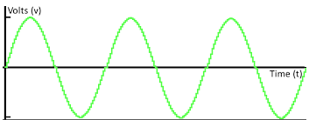

ADC

Slide 5

ADC

Slide 6
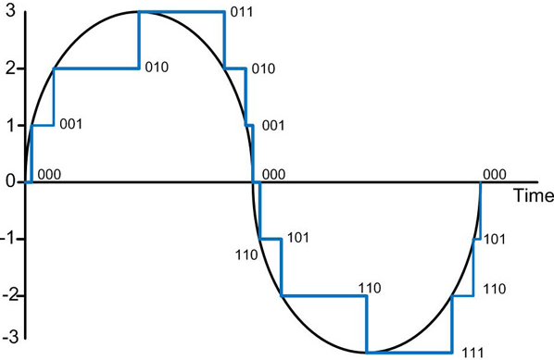
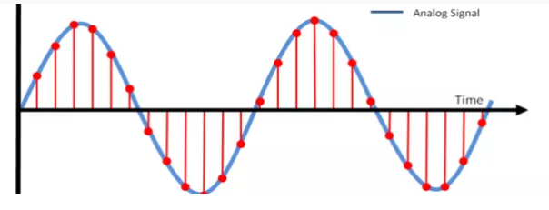
ADC

Slide 7
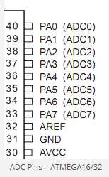
ADC

Slide 8
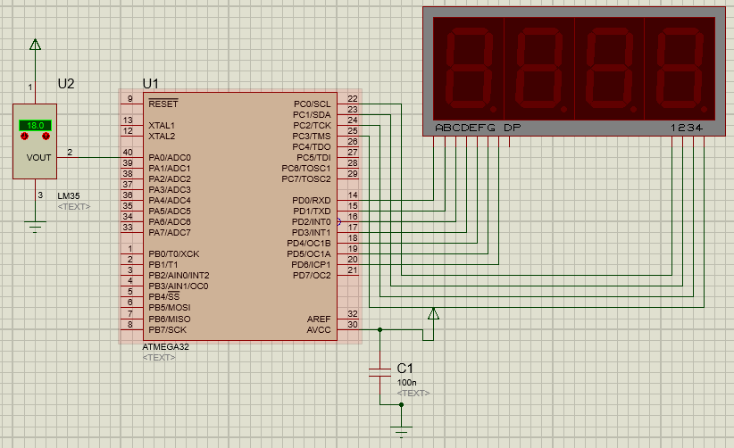

Slide 9
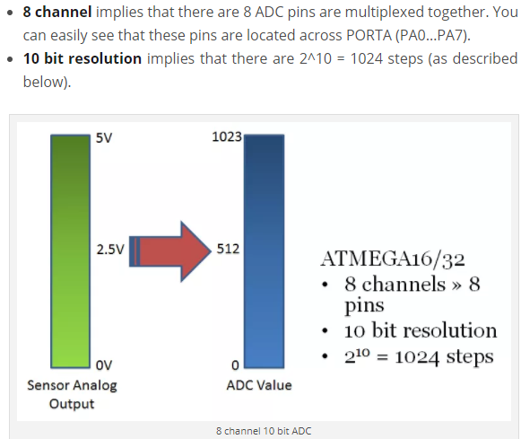
ADC

Slide 10
ADC
Do for All channels at once for ADC Initialization:
Reference Selection
Pre-scaler Selection
Enabling ADC
Do before reading ADC:
Channel Selection
Start Conversion
Read Data

Slide 11
ADC
ADC Channels
Do for All channels at once:
Reference Selection
Pre-scaler Selection
Enabling ADC
Do before reading ADC:
Channel Selection
Start Conversion
Read Data
ADC Registers:
1. ADMUX
2. ADCSRA
3. ADCL, ADCH

Slide 12
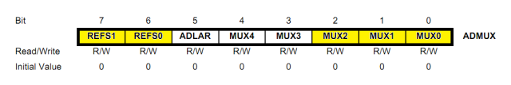
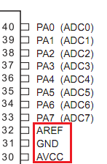
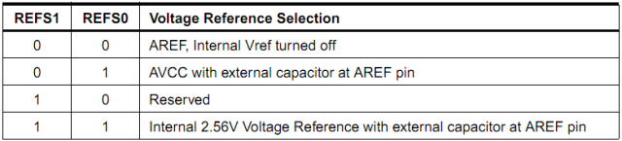
ADC
ADMUX – ADC Multiplexer Selection Register
Do for All channels at once:
Reference Selection
Pre-scaler Selection
Enabling ADC
Do before reading ADC:
Channel Selection
Start Conversion
Read Data
The bits that are highlighted are of interest to us.
Bits 7:6 – REFS1:0 – Reference Selection Bits

Slide 13
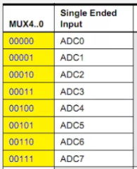
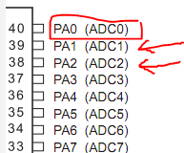
ADC
ADMUX – ADC Multiplexer Selection Register
Do for All channels at once:
Reference Selection
Pre-scaler Selection
Enabling ADC
Do before reading ADC:
Channel Selection
Start Conversion
Read Data

Slide 14
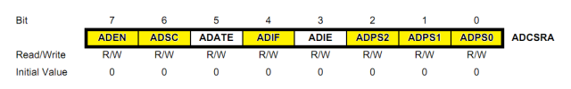
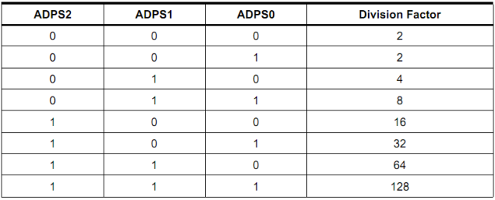
ADC
ADCSRA – ADC Control and Status Register A
Do for All channels at once:
Reference Selection
Pre-scaler Selection
Enabling ADC
Do before reading ADC:
Channel Selection
Start Conversion
Read Data

Slide 15
ADC
ADCSRA – ADC Control and Status Register A
Do for All channels at once:
Reference Selection
Pre-scaler Selection
Enabling ADC
Do before reading ADC:
Channel Selection
Start Conversion
Read Data
Bit 7 – ADEN – ADC Enable
Bit 6 – ADSC – ADC Start Conversion

Slide 16
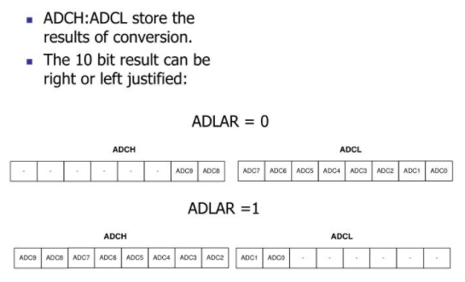
ADC
ADCL and ADCH – ADC Data Registers

Slide 17
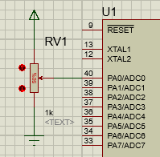
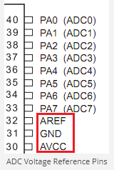
ADC
Coding:
ADC Initialization()
{
Reference Selection //ADMUX
Pre-scaler Selection //ADCSRA
Enabling ADC //ADCSRA
}
Read ADC()
{
Channel Selection //ADMUX
Start Conversion //ADCSRA
Read Data // ADCL, ADCH or ADCW
}

Slide 18
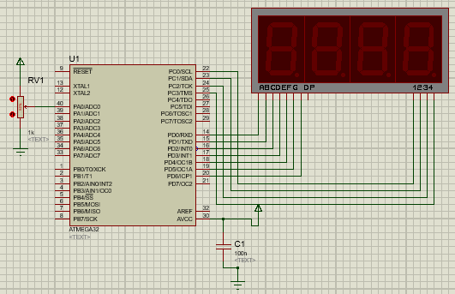
ADC

